Slide 1
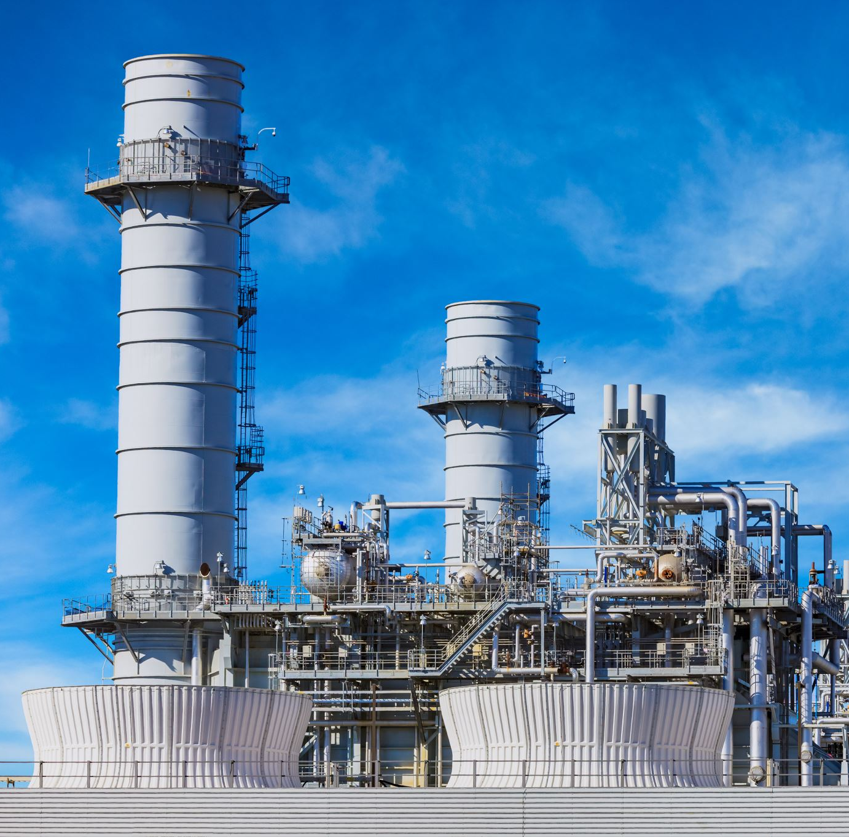
Integrated Predictive Maintenance and Energy Forecasting Platform for Industrial Optimization
Presenting by
Bhuvanachandra Kaseedu 1692143
SriRag Ajith 1688718

Slide 2
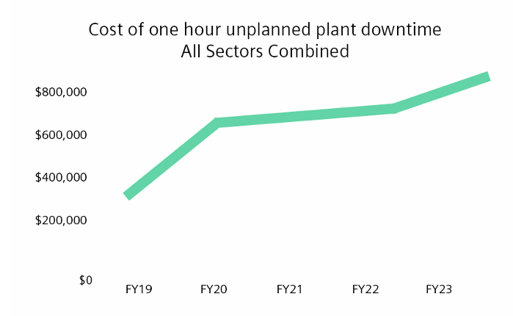
Introduction
Why Predictive Maintenance Matters: Unexpected equipment failures and inefficient energy usage lead to significant financial losses across industrial sectors.(The accompanying graph illustrates the downtime costs across all industries.)
Solution: Developing an AI-driven platform that combines predictive maintenance with energy consumption forecasting to optimize industrial operations
Key benefits:
Minimize unplanned equipment downtime
Accurately forecast and manage energy costs
Optimize maintenance schedules through data-driven insights

Slide 3
Flow of Execution
Data Acquisition
Data Processing
Predictive maintenance and energy forecasting models
Integration and optimization
Visualization & Dashboard
User actions on alerts

Slide 4
Data Sources
CMAPSS Dataset
NASA collected data from 100 engines, each with about 21000 samples.
Each sample includes 23 sensor readings and 3 operational settings.
The dataset is used to predict the remaining life of engines over time.
Steel Industry Energy Dataset
Real-time energy consumption data recorded from a steel plant at hourly intervals.
Includes features like energy usage, ambient temperature, and operational settings affecting power needs.
Synthetic Data Generation
From the combined data set of both CMAPSS and Energy forecasting.

Slide 5
Technologies Used
Python 3.11.13
Pandas Num-Py
Sci-Kit Learn, Prophet
Streamlit, Matplotlib
NGrok (PyNGrok)
Google Colab
Data Processing
Machine Learning
Web Visualization
Cloud Environment
Code Base
Networking

Slide 6
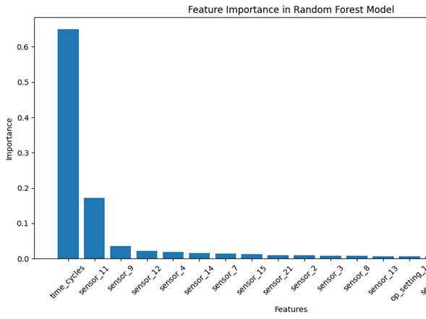
Data Preprocessing
CMAPSS Data:
Feature selection (operational settings, key sensors)
RUL calculation per unit
Handling missing values and scaling features
Steel Industry Data:
Time alignment and resampling
Encoding categorical variables
Filling missing values

Slide 7
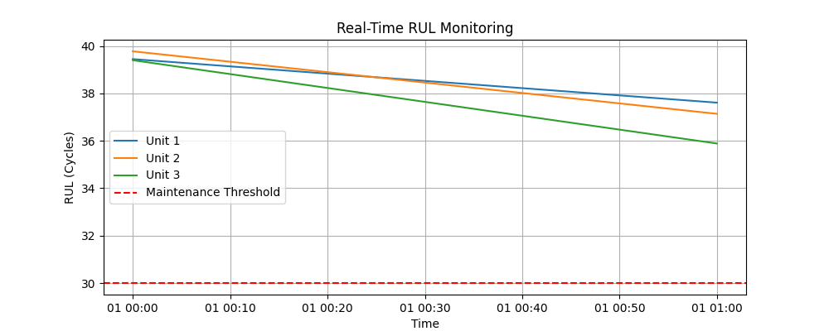
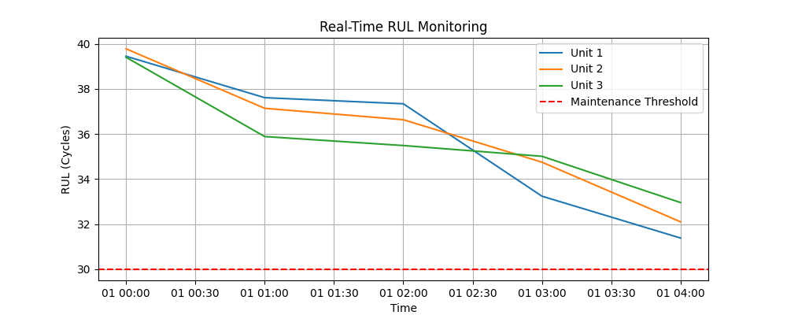
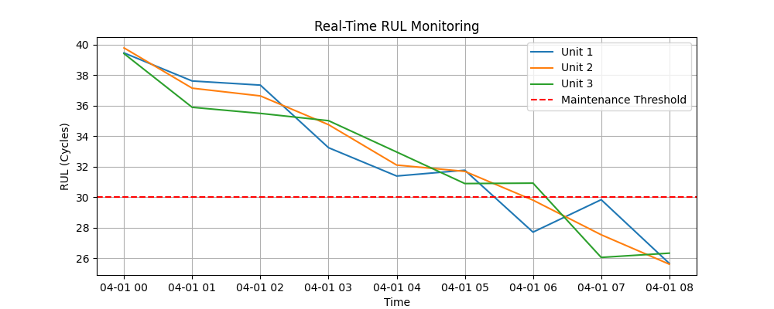
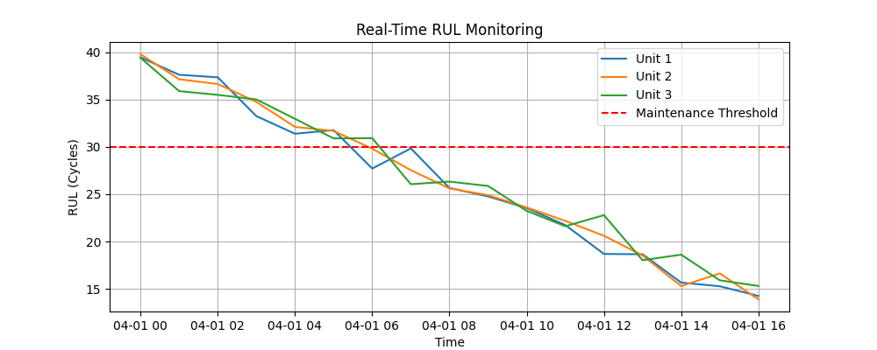
Predictive Maintenance Model
Algorithm: Random Forest Regressor
Features: Selected engine sensors and operational settings
Target: Remaining Useful Life (RUL)
Performance Metrics:
RMSE: 25 Cycles
R² Score: 0.64

Slide 8
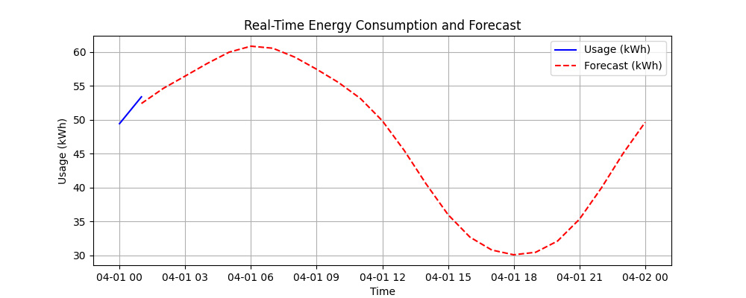
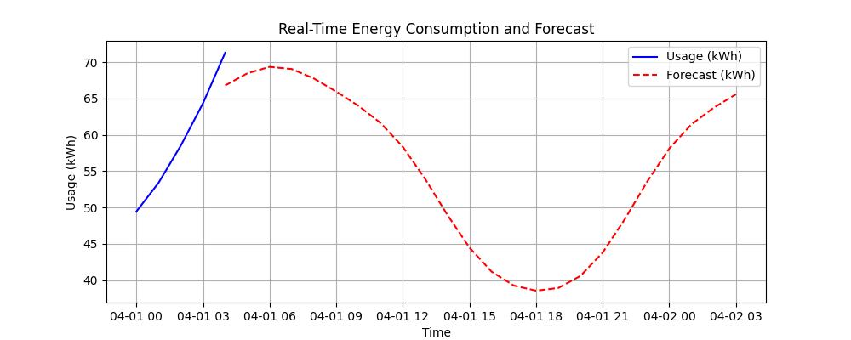
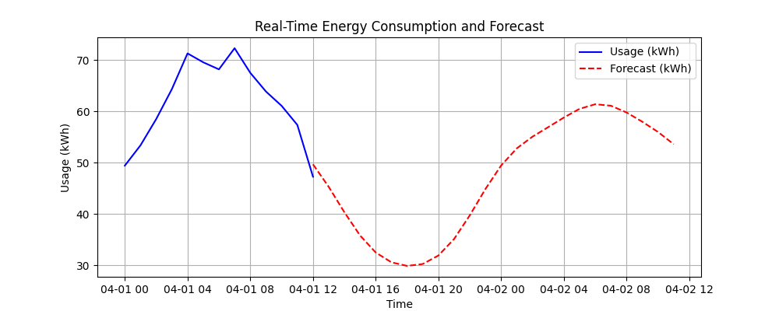
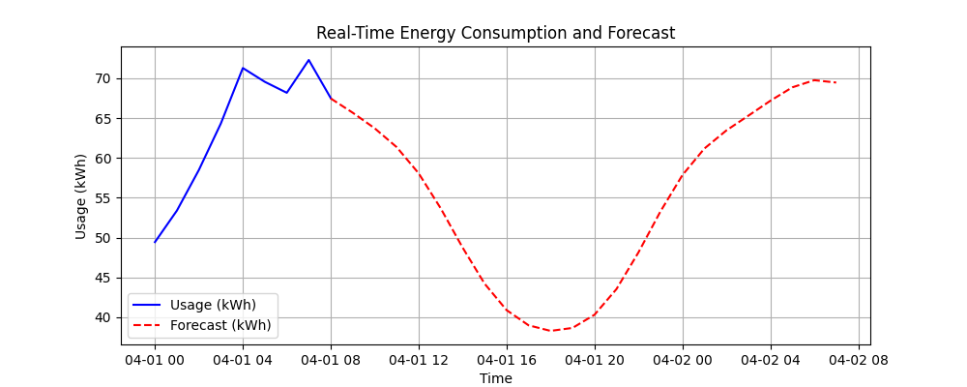
Energy Forecasting Model
Algorithm: Prophet Time Series Model
Features:
Historical energy usage
Power factors
Load types and time variables
Performance Metrics:
MAPE (Mean Absolute Percentage Error)
RMSE (Root Mean Squared Error)
Forecast Horizon:
Next 7 days, hourly resolution

Slide 9

Integration & Optimization
Combined Dataset:
Merged maintenance predictions with energy forecasts using timestamps
Maintenance Scheduling:
Identify units with low RUL (<30 cycles)
Schedule maintenance during periods of lower forecasted energy cost
Output:
Exported integrated maintenance schedule for cost-effective planning

Slide 10
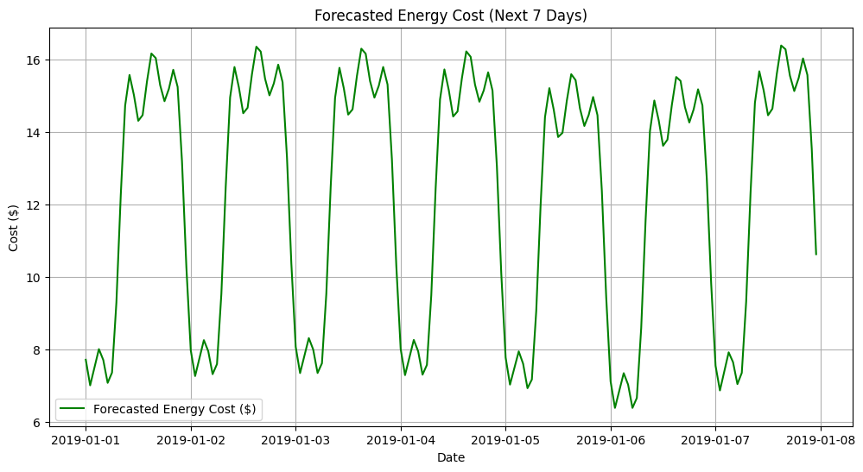
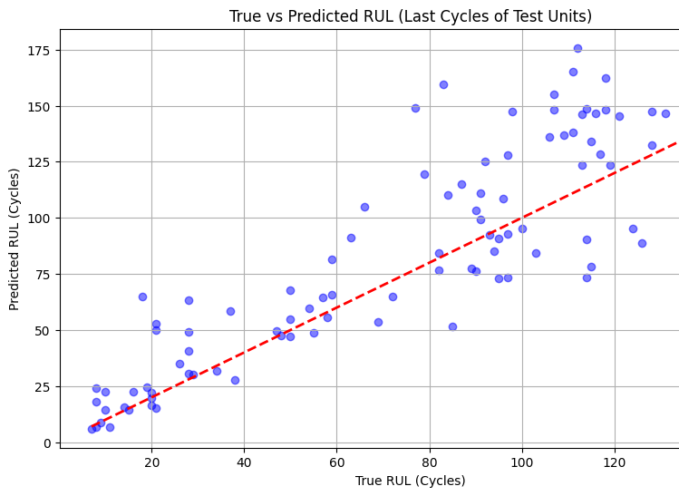
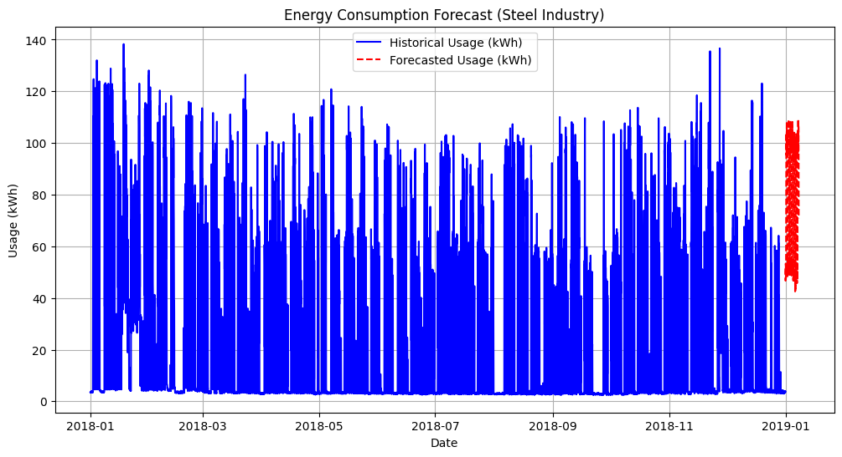
Visualization & Dashboard
Plots:
Actual vs. Predicted RUL for sample units
Feature importance for PdM
Historical and forecasted energy consumption
Forecasted energy cost
Real-Time Dashboard:
Streamlit app for live monitoring and scheduling

Slide 11

Results & Insights
PdM Model:
Achieved low RMSE and high R² on test data
RMSE: 25 Cycles. R² Score: 0.64
Energy Forecasting:
Accurate short-term forecasts, actionable cost estimates
MAPE: 9.65%. RMSE: 65.36 kWh
Integrated Scheduling:
Demonstrated potential cost savings and downtime reduction

Slide 12

Conclusion & Future Work
Summary:
Successfully built an integrated AI platform for predictive maintenance and energy optimization
Future Enhancements:
Incorporate more advanced models (e.g., deep learning)
Expand to other industrial datasets
Deploy in real-world industrial settings

Slide 13

Let's explore the demonstration together.

